Slide 1
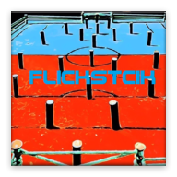
Flick Stick
An Android Mobile Soccer Game
Anthony Menjivar
January 21, 2015

Slide 2
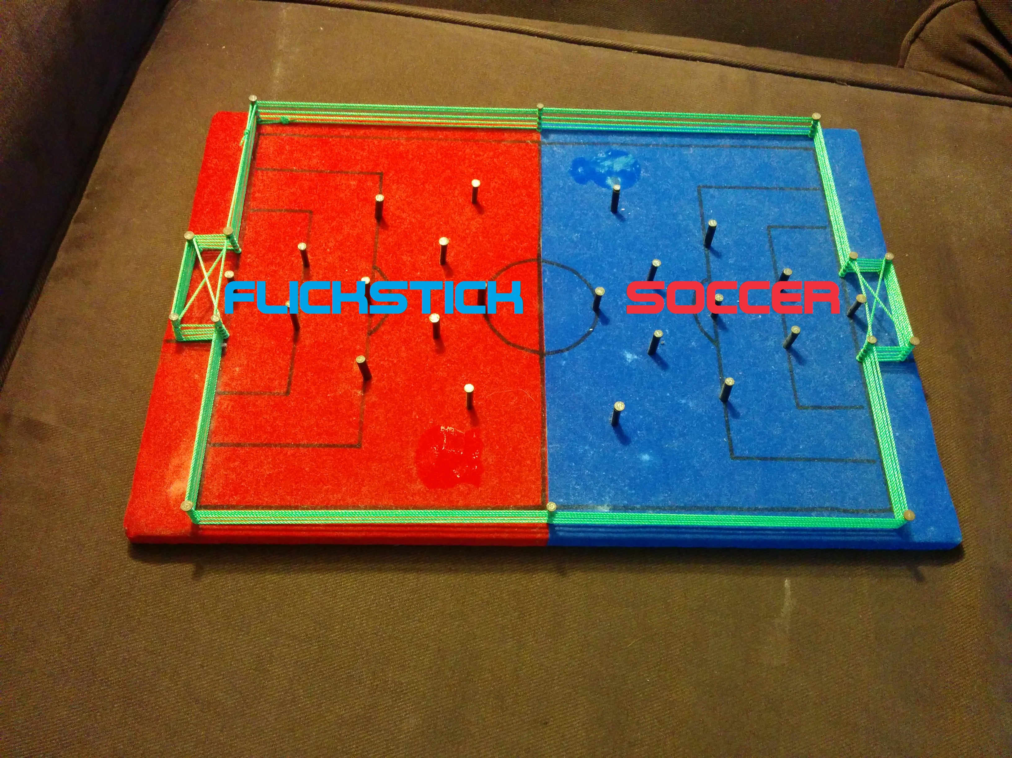
Flick Stick Description
Layout
Soccer Field
22 sticks (11 on each side)
Obstacles in Pre-Determined Formation
Game Play
2 players (1v1, 1vRobot, Tournament)
1st player flicks ball from starting point towards goal to score
Players take turns flicking the ball
First to certain amount of goals wins

Slide 3
Project Goals
Learn Steps for an Application
Work with Android APIs
Run a Smooth, Fun and Exciting Android Soccer Game
Beginning Steps for Game Development

Slide 4
Justification
Game Inspiration + Interest
Soccer
Video Games (Mobile)
Abilities
Java, Android, etc.
LMU Curriculum
Java, Data Structures, Graphics, etc.

Slide 5
Screen Shots/Demo

Slide 6
Project Challenges
Learning as I go
Falling behind
Use on different devices (screen sizes)
Android (Framework, APIs)
Cleaning up Code

Slide 7
Status Update
Accomplishments
Finished Games’ Framework
Coded All Game States
Plans
Clean up Sprites/Smooth Gameplay (Soccer Ball)
Finish Robot Mode
Finish Tournament Mode
Scoring
Stick Collision
Add Sound

Slide 8
Thank You!

